Slide 1
CISCO Icon Library Network Diagrams

Slide 2


Wired Access Point

Slide 3











ATM Router

Slide 4


Cloud

Slide 5











Laptop

Slide 6











Modem

Slide 7











Phone

Slide 8


Printer

Slide 9










Router

Slide 10


TV Streaming Device

Slide 11

Smart Home Device

Slide 12

Printer

Slide 13

Gaming Console

Slide 14

Tablet (iPad)

Slide 15

Computer (Desktop)

Slide 16

Television

Slide 17











Wireless Bridge

Slide 18
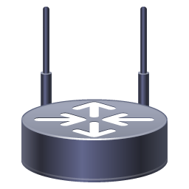










Wireless Router

